Slide 1
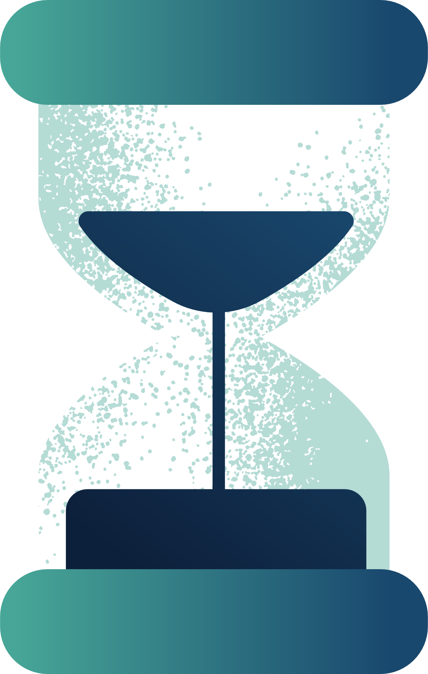

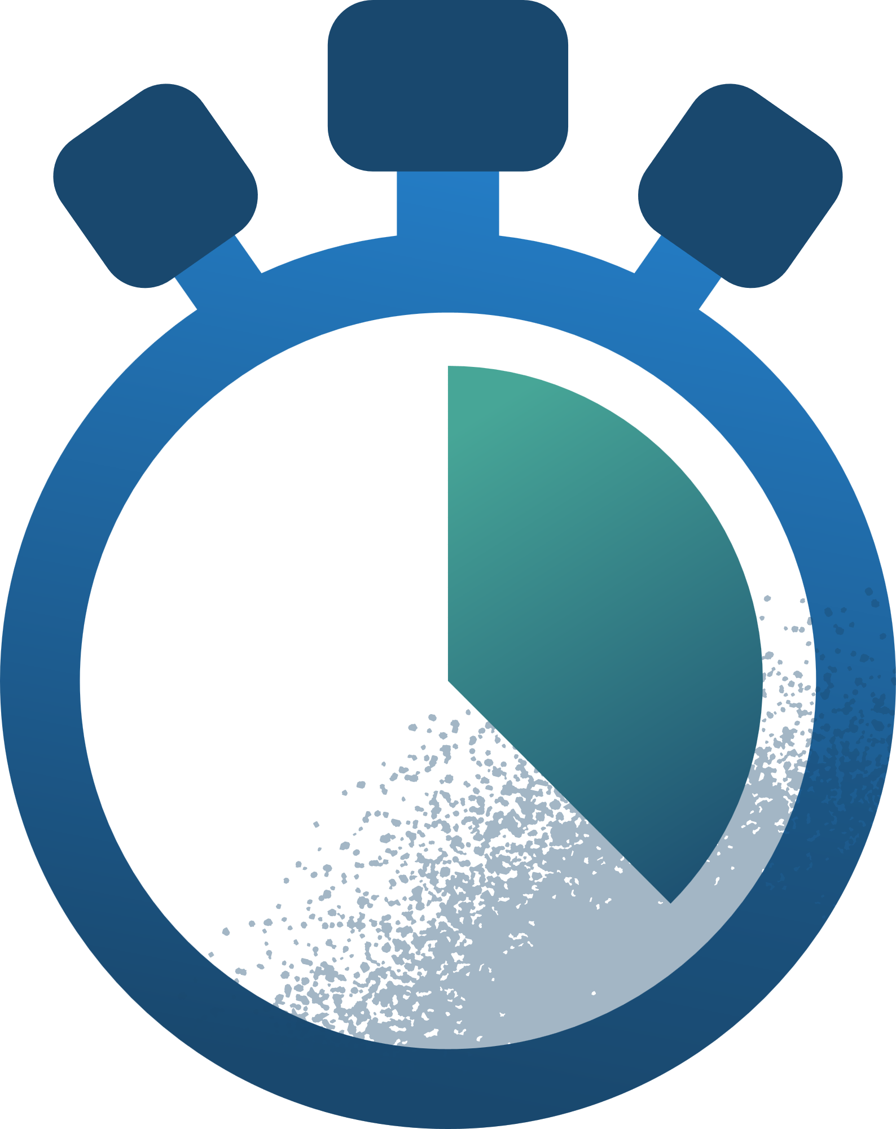
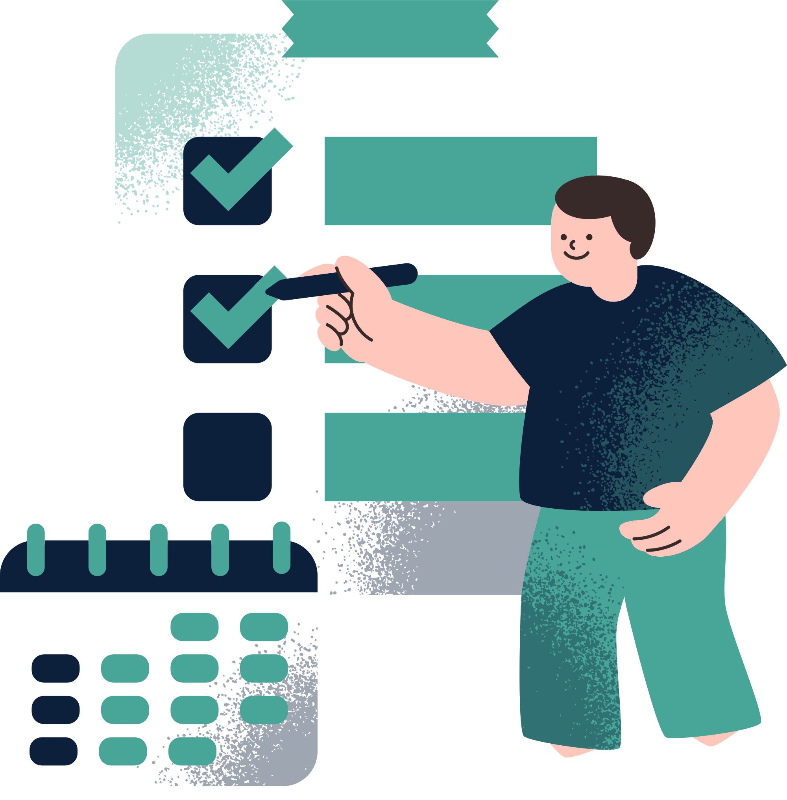
BRAINBUDDY
Mobile ADHD Management App
Key to Productivity and Efficiency
Ofir Berkovitsh Zukerman 208080705
Alon Barak 207758525
Supervisor:
Dr. Natali Levi

Slide 2

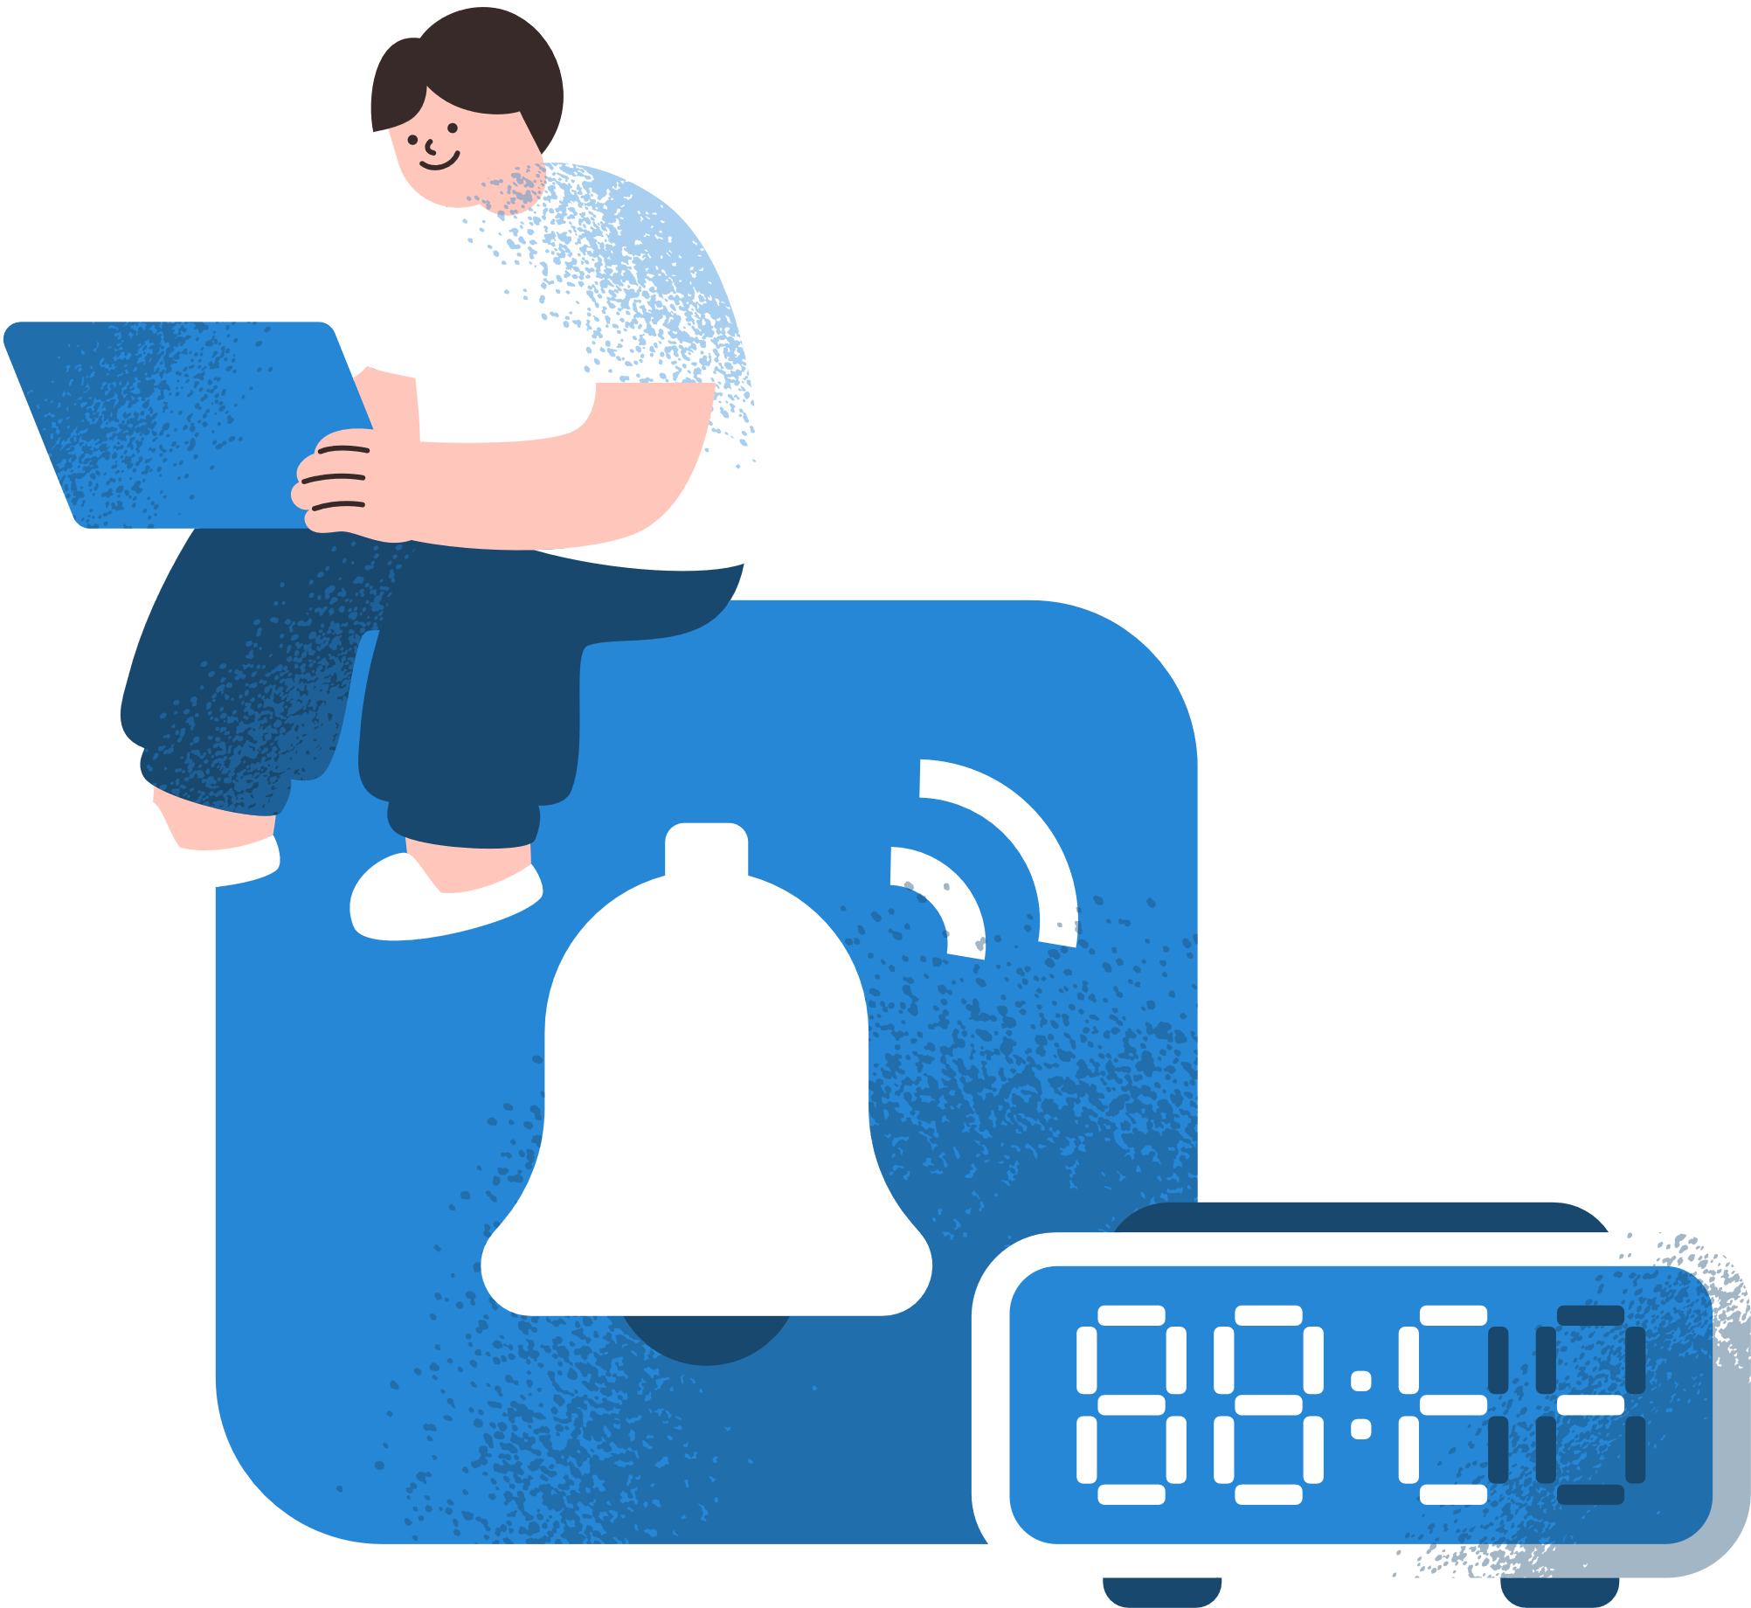
Background on ADHD
What is ADHD?
ADHD (Attention Deficit Hyperactivity Disorder) is a neurodevelopmental disorder.
Key symptoms include:
Inattention: Difficulty focusing on tasks.
Hyperactivity: Restlessness and constant movement.
Impulsivity: Acting without forethought.
Impact:
Affects both children and adults.
Creates challenges in daily organization, task management, and productivity.

Slide 3

Research Phase
Objective:
To understand the unique challenges faced by individuals with ADHD and identify gaps in existing solutions.
Key Insights from Research:
Executive Function Deficits
Digital Solutions
Personalization Matters
89-98% of ADHD adults struggle with time management and organization.
Structured routines and tools significantly improve task completion rates.
Users prefer tools with clear visual aids, adaptive scheduling, and real-time feedback
A "one-size-fits-all" approach is ineffective for ADHD users.
Customizable features enhance usability and engagement.

Slide 4

Interview
איתמר (משתמש עם ADHD):
"אני מתחיל משימה ואז שוכח מה רציתי לעשות. קשה לי לדעת מאיפה להתחיל כשהכל מרגיש דחוף."
לי (משתמשת עם ADHD):
"כלי שיעזור לי לקבוע סדרי עדיפויות ישנה לי את החיים. אני נוטה להתמקד בדברים קטנים ולדחות את הדברים החשובים."
איתמר (משתמש עם ADHD):
"אני עובד הכי טוב בבוקר, אבל לפעמים אני מבזבז את הזמן הזה על משימות קלות כי אני לא יודע איך לארגן את היום."
What We Learned?
Struggles with prioritization:
Users reported difficulty distinguishing between urgent and non-urgent tasks, leading to confusion and inefficiency.
Time-based task management:
Participants expressed a preference for scheduling complex tasks during their most productive times, such as mornings.
Simplified tools are essential:
Many users found existing tools overwhelming, emphasizing the need for a minimal and intuitive design.
Reminders help maintain focus:
Personalized reminders can keep users on track without creating additional stress.

Slide 5

Problem
ADHD individuals face significant challenges in daily organization, time management, and task prioritization due to deficits in executive functions.
Disorganized routines and environments.
Inefficient time management.
Difficulty prioritizing tasks based on urgency and importance.
These challenges can result in missed deadlines, increased stress, and lower productivity.

Slide 6
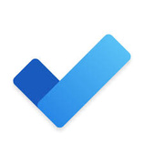
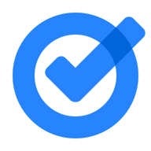



Competitive Analysis
Traditional Task Apps:
Existing ADHD Apps:
Microsoft TODO
Google Tasks
Clarify
Univi
Generic one-size-fits-all approach
Limited customization options
Complex interfaces
No ADHD-specific features
Overwhelming number of features
Fixed task management systems
Focus mainly on medication reminders
Limited task management capabilities
Lack intelligent task prioritization
No adaptive scheduling
Minimal personalization options

Slide 7

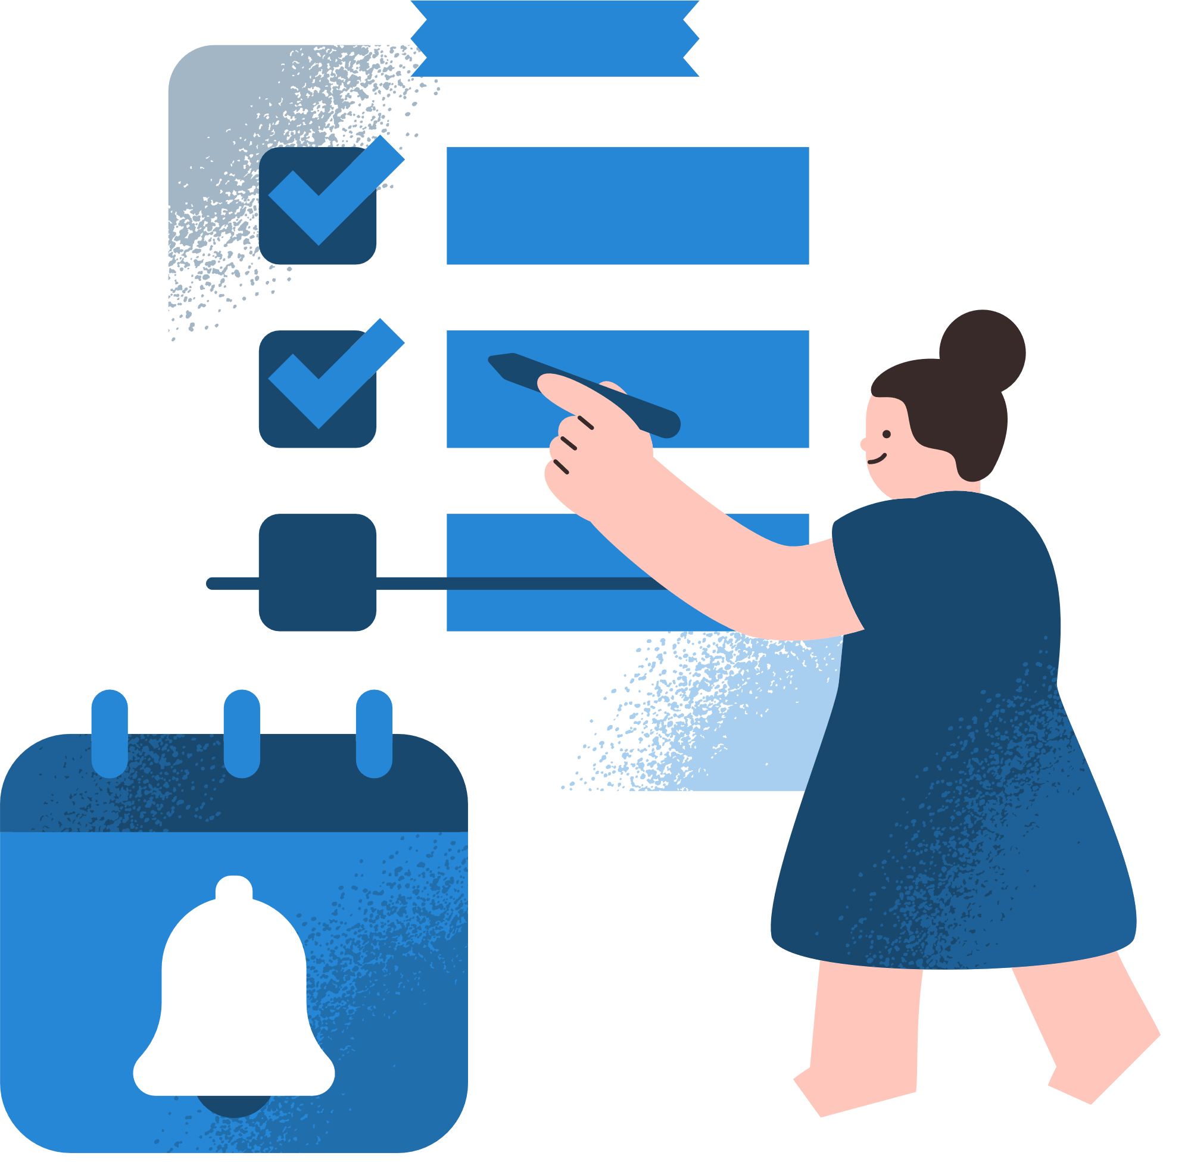
Proposed Solution
What is BrainBuddy?
BrainBuddy is a mobile app designed to empower users with ADHD to:
Create and prioritize tasks based on urgency, complexity, and deadlines.
Generate personalized daily schedules.
Receive adaptive reminders to stay focused.
Vision:
To create a structured, stress-free daily routine that aligns with the user's unique cognitive needs.

Slide 8
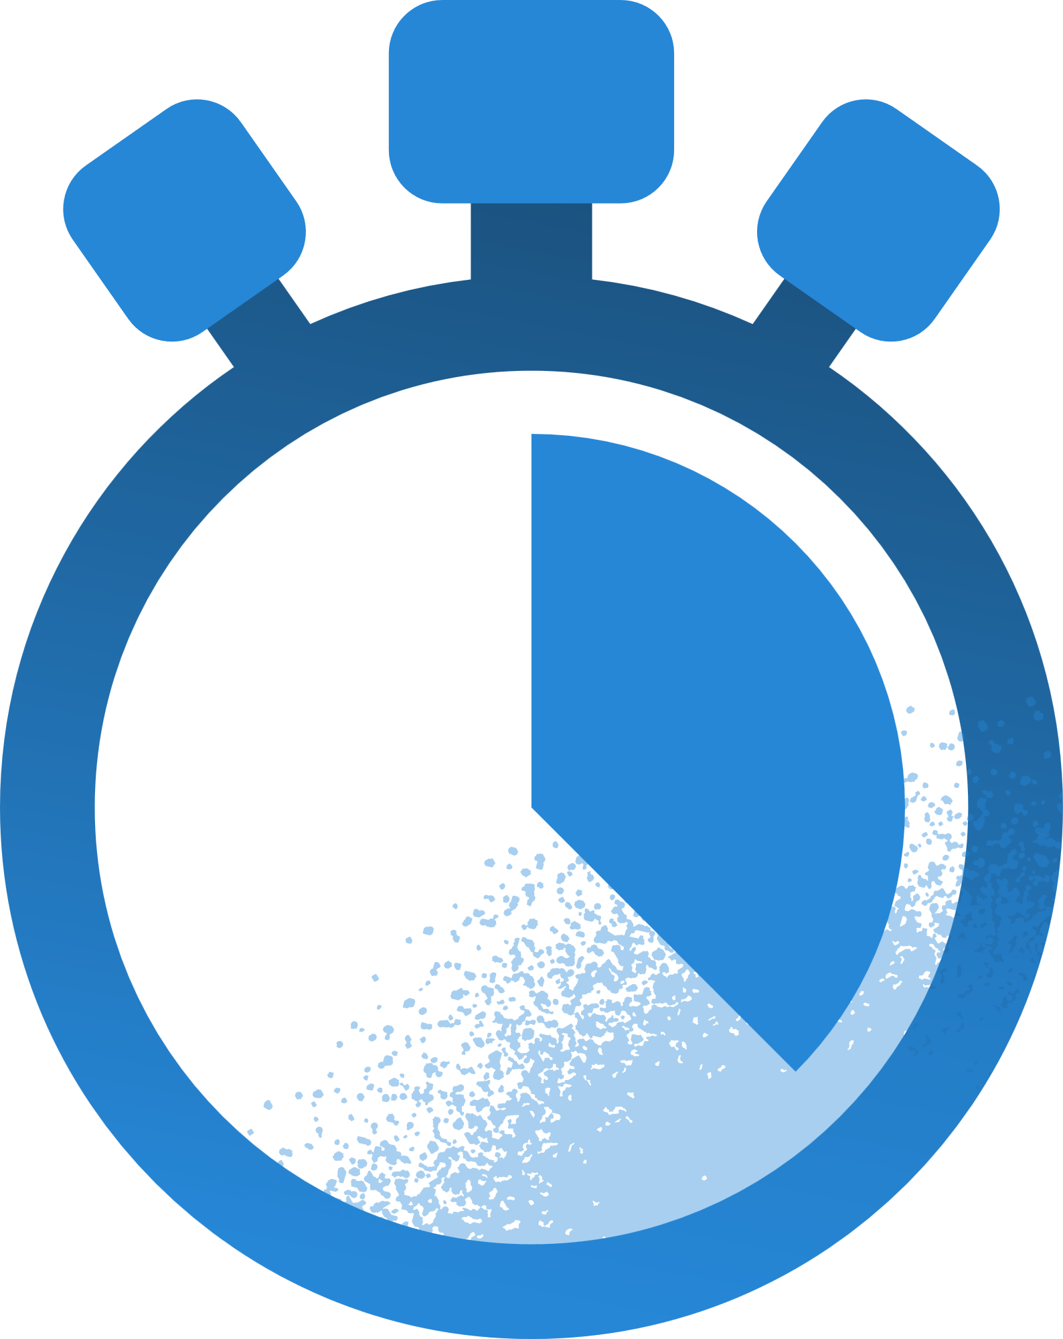
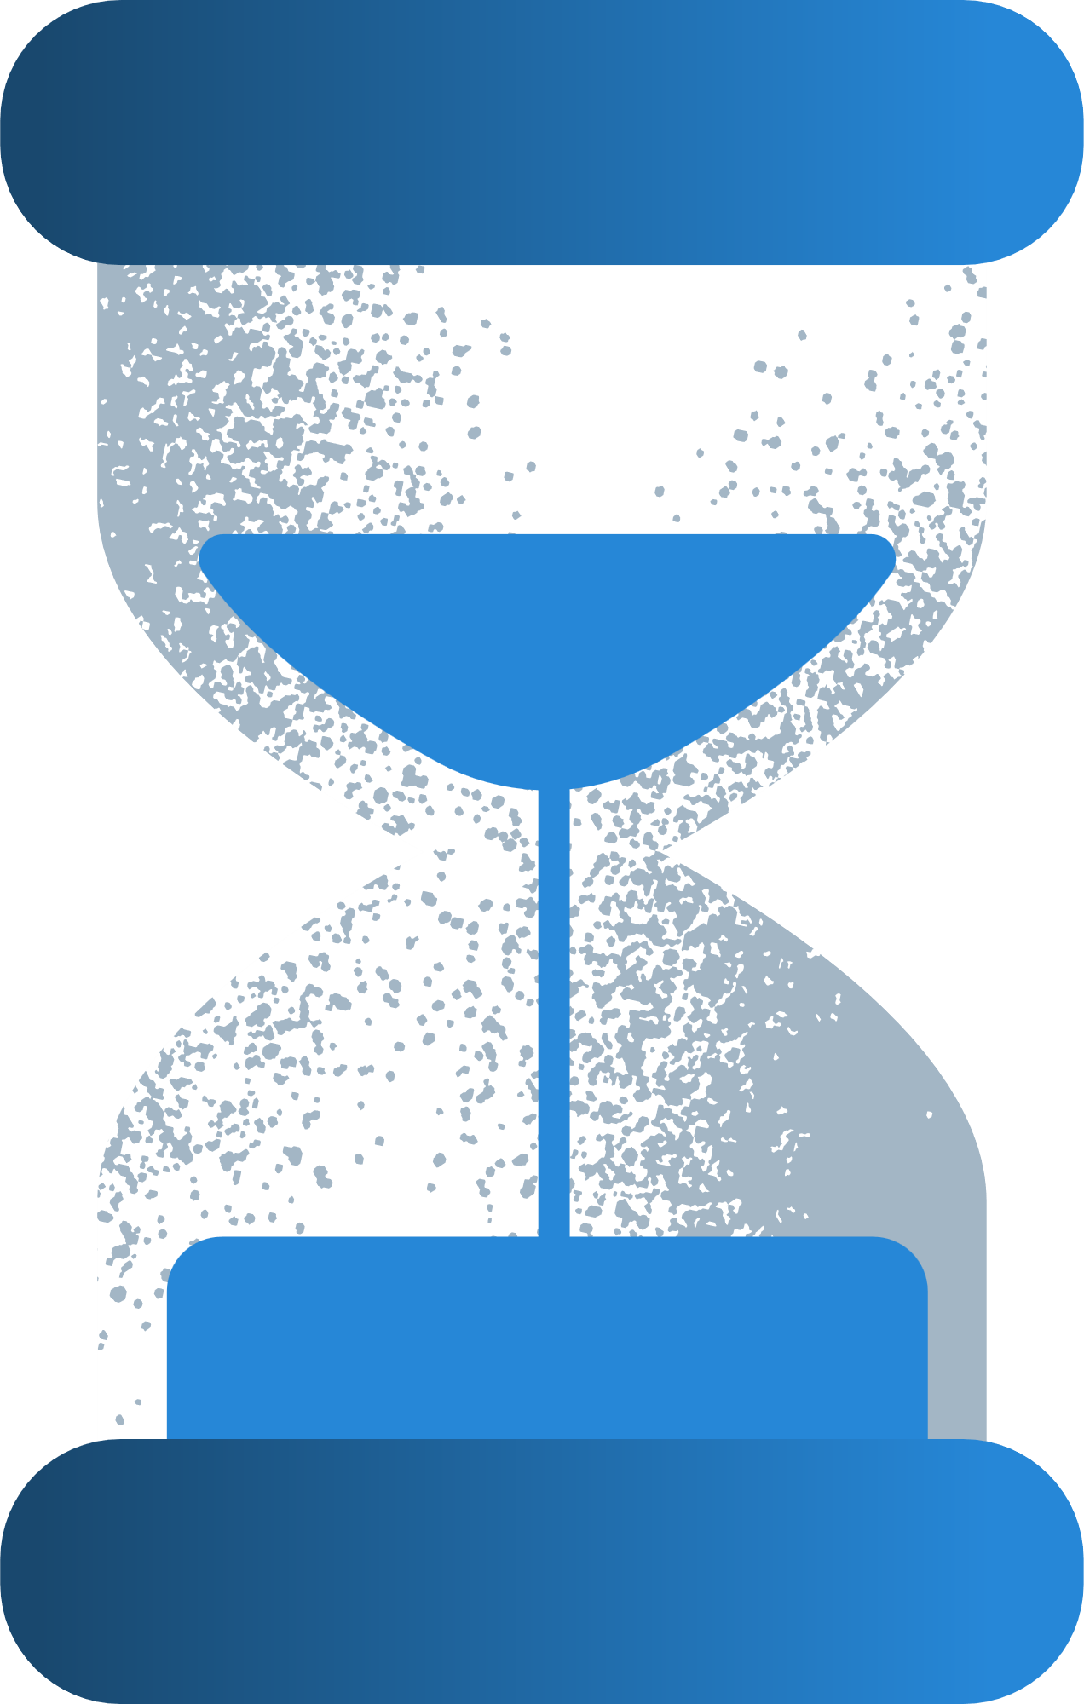
Target Audience
BrainBuddy is tailored for:
people that seeking tools to manage disorganization and deadlines
Adults and children diagnosed with ADHD
Individuals looking for structured task and time management solutions.
Why ADHD users?
ADHD individuals often lack systems to manage executive function deficits. BrainBuddy addresses this gap with a focused and supportive approach.

Slide 9
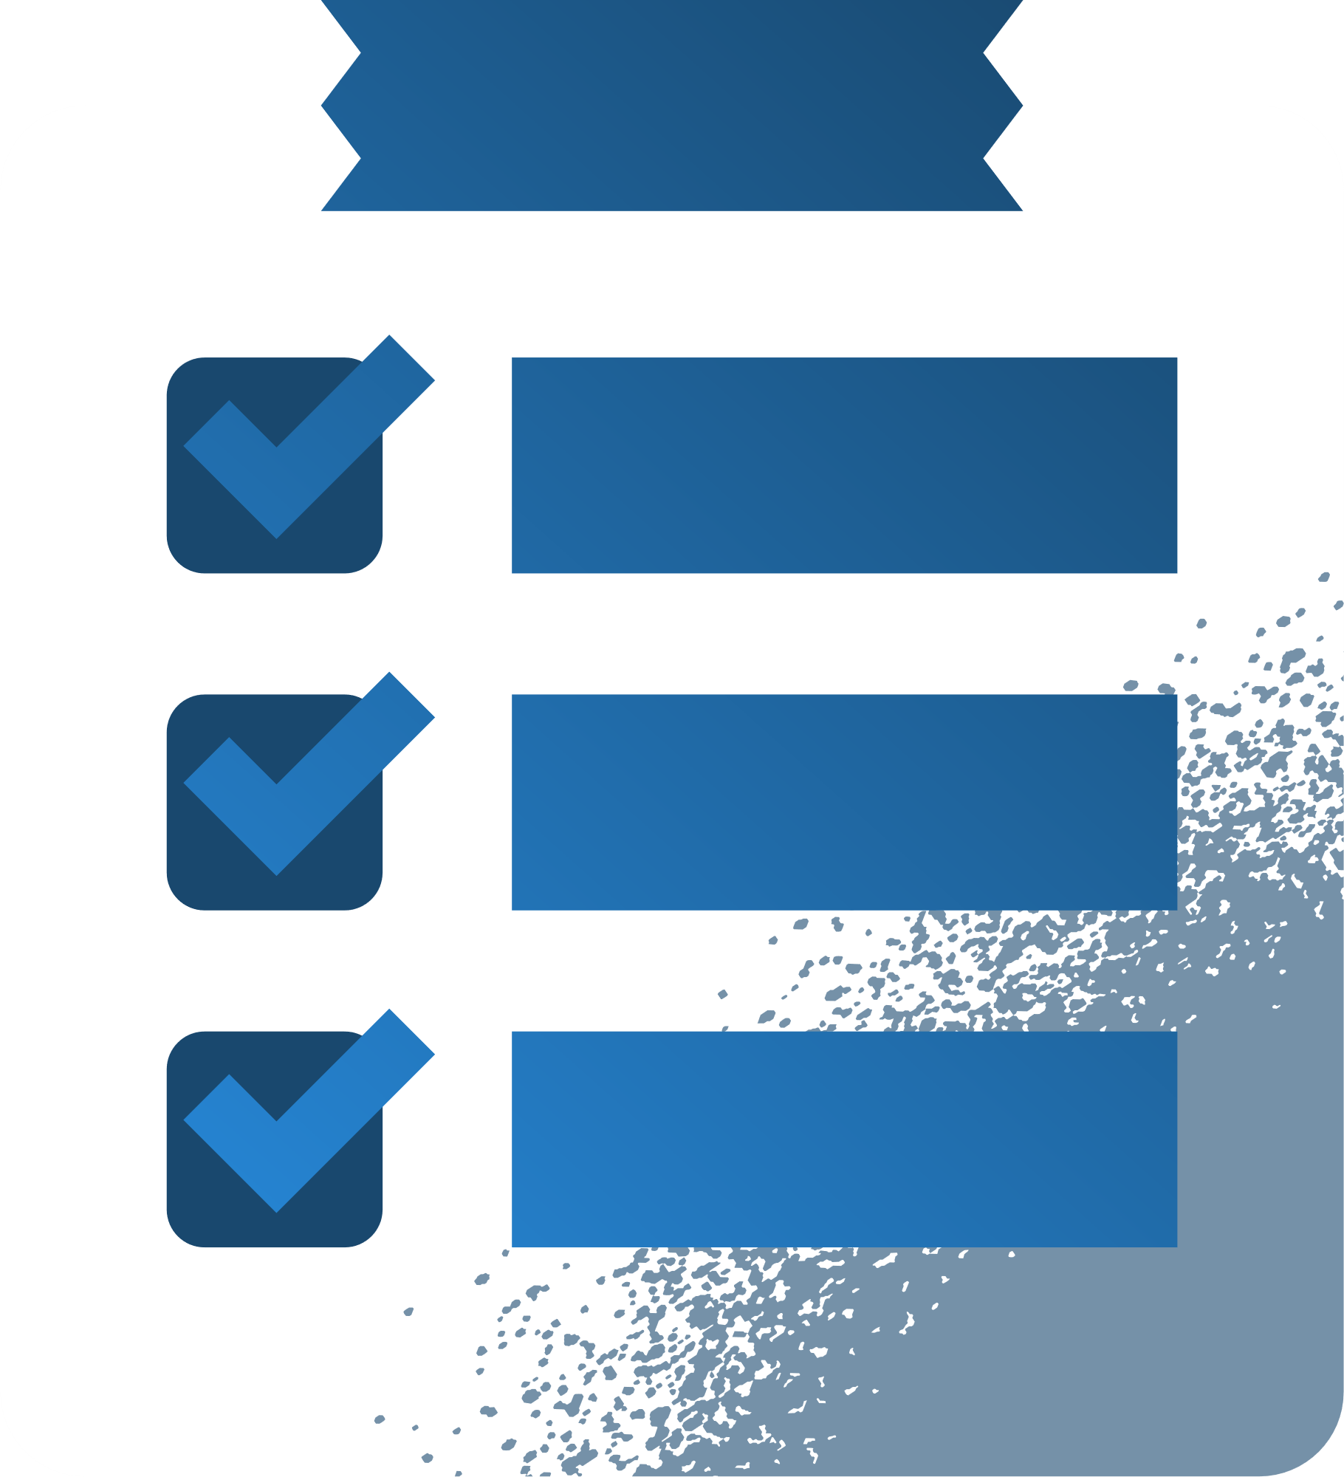
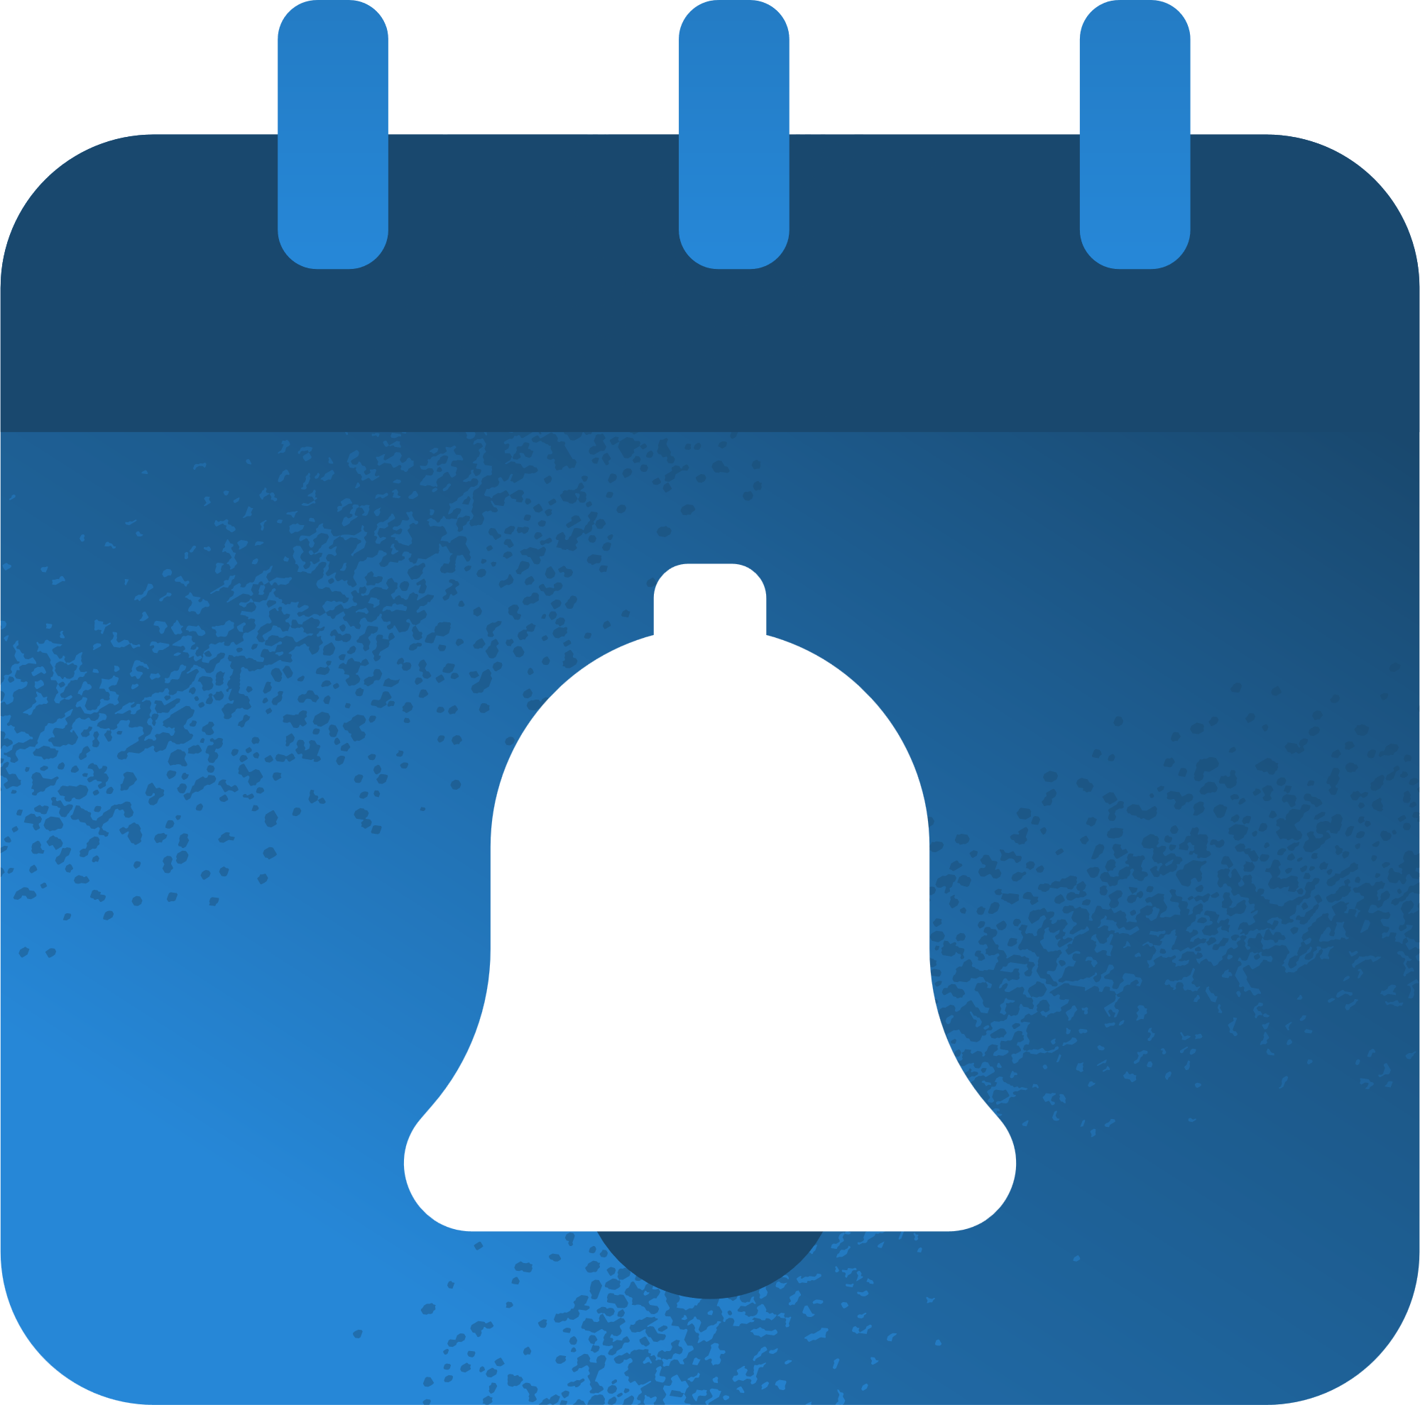
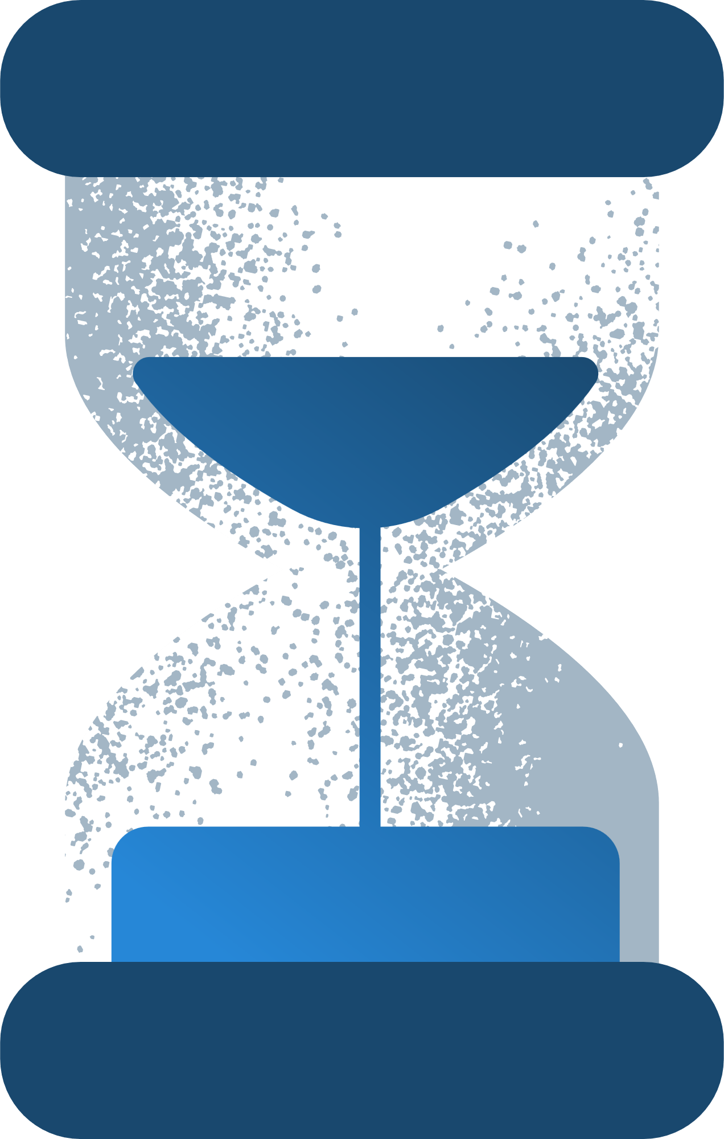
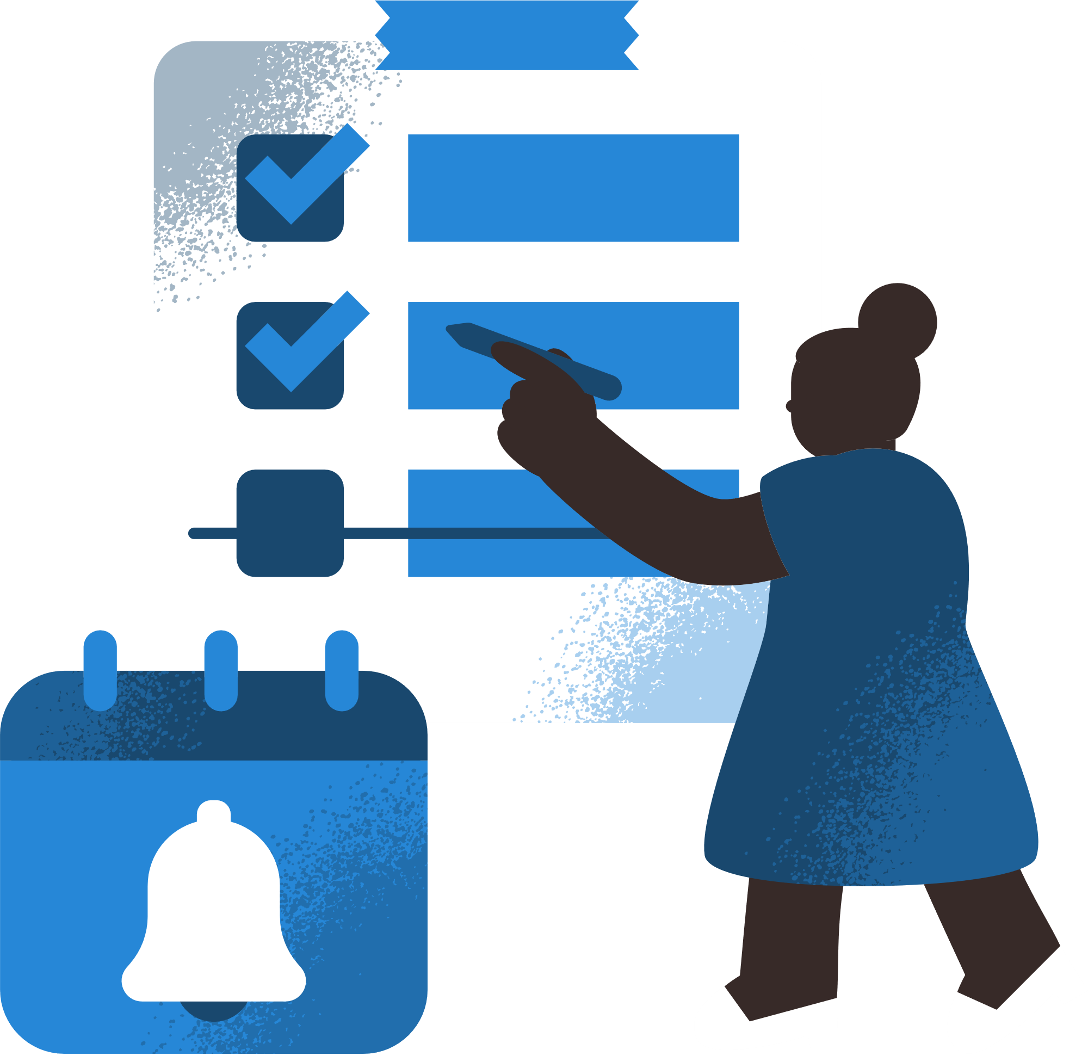
Core Features
Dynamic Scheduling
Adaptive Reminders
ADHD-Friendly Interface
Task Creation
Users can add tasks with attributes like urgency, difficulty, and recurrence
Three optimized schedule options generated daily
Notifications to prompt focus and task completion
Visual aids and color coding for clarity.
Clean design to minimize distractions

Slide 10
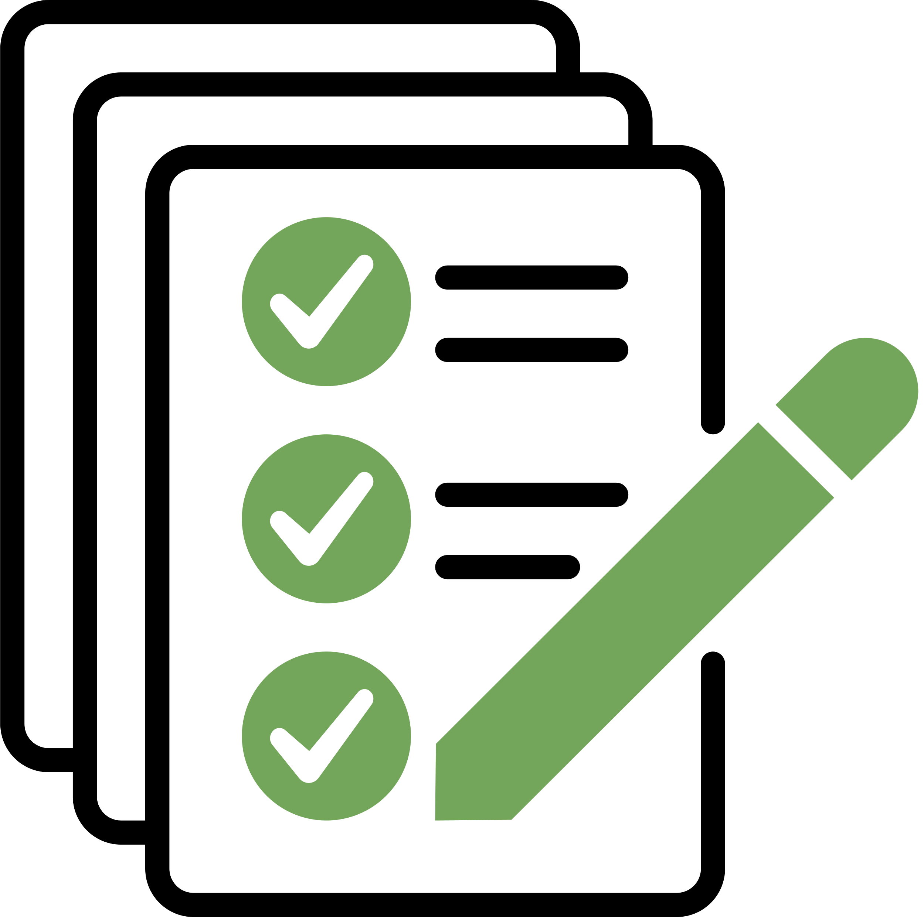
Requirements
Functional Requirements:
The application must allow users to input tasks.
The application will enable users to mark tasks as complete or leave them pending.
The application must update the status of tasks and remove completed tasks from the active list.
The application must calculate and present three task schedule options tailored to the user’s preferences.
Non-Functional Requirements:
The tasks can be inserted with attributes such as name, urgency, difficulty, deadline, duration, and recurrence type (daily, weekly, or monthly).
Preferences will be set for attributes such as notification times and their available time blocks.
The system will offer an ADHD-friendly interface with clear, intuitive navigation and features such as large buttons and readable fonts.

Slide 11




User Interface (UI)
Based on Jakob Nielsen's 10 Usability Heuristics
Design Principles:
Key Screens:
Simplicity
Dashboard
Minimal distractions, intuitive layout
Overview of tasks and progress
Accessibility
Focus Mode
Large buttons, readable fonts, color coding
Timer to track task completion
Customization
Task Creation
Adjustable features to suit user needs
Simple form to input and prioritize tasks

Slide 12

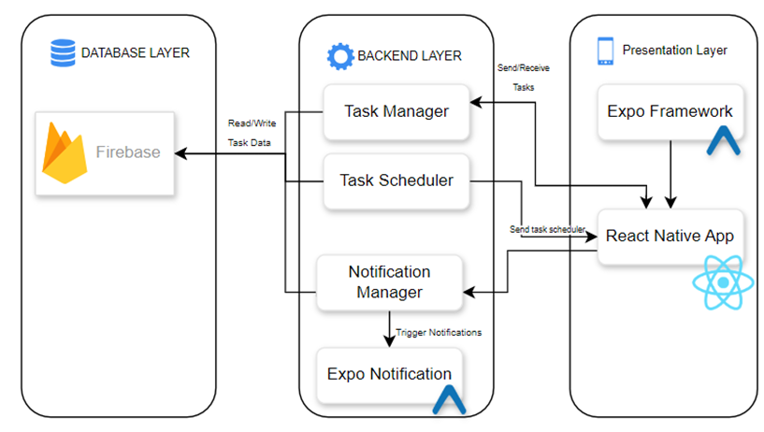
Architecture Overview
Technologies Used:
Frontend: React Native for cross-platform support.
Backend: Firebase for real-time database management and notifications.
Modular Design: Ensures scalability and flexibility.
Architecture Layers:
Presentation Layer (UI/UX).
Application Layer (Algorithms, Logic).
Data Layer (Firebase).

Slide 13
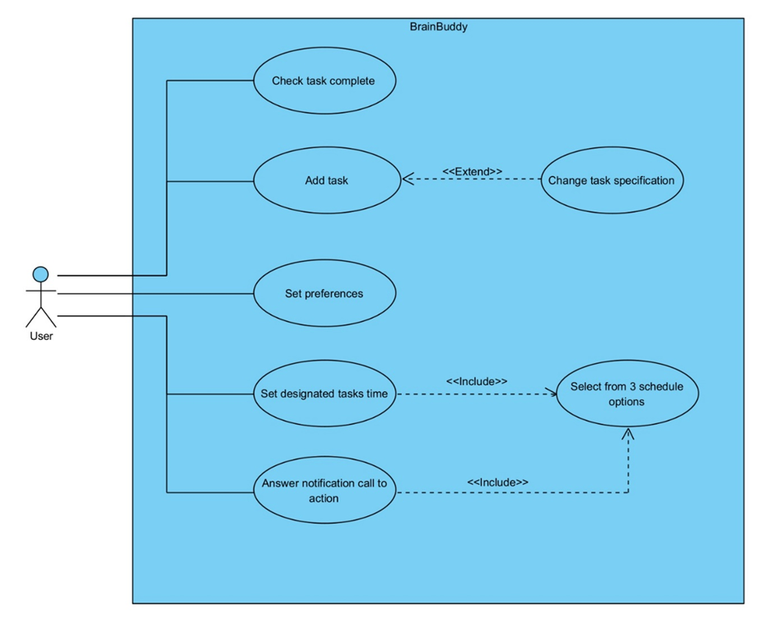
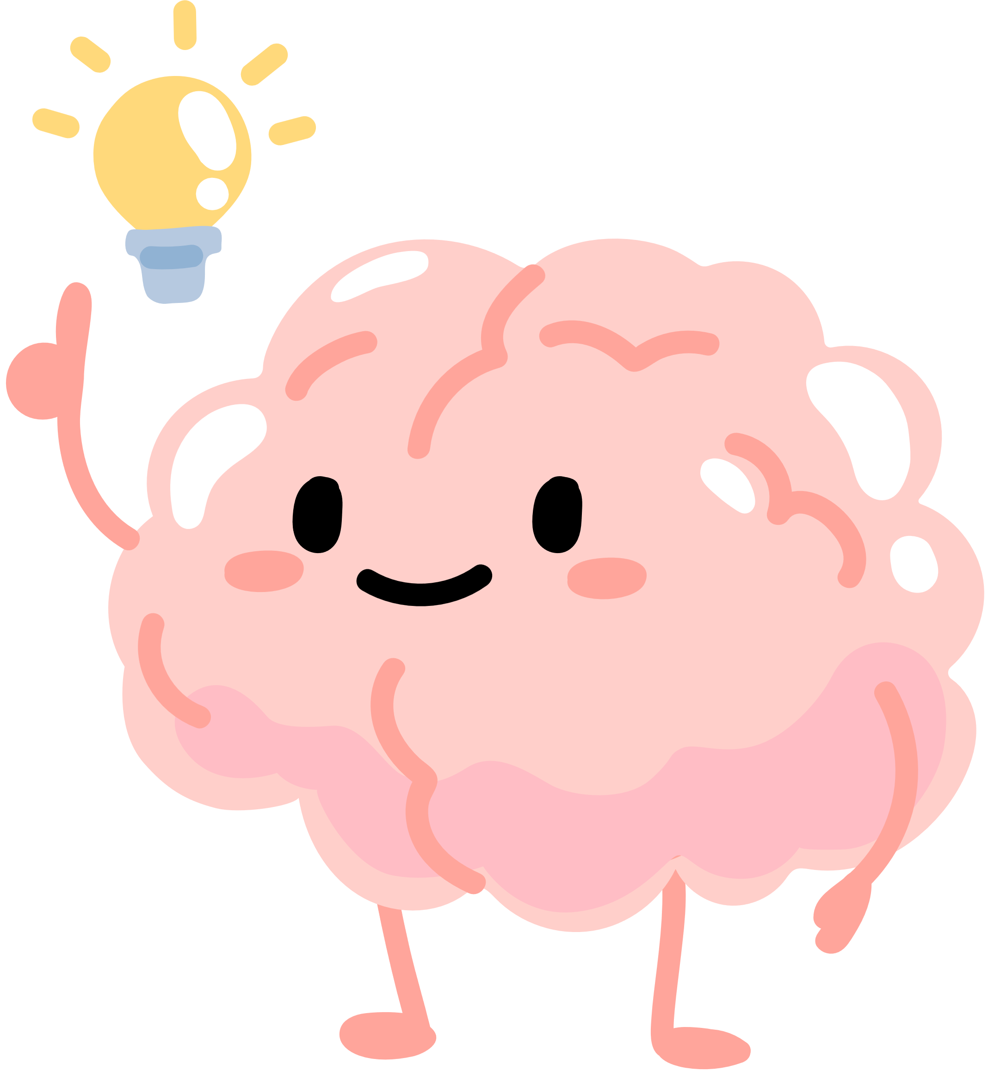
Use Case Diagram

Slide 14
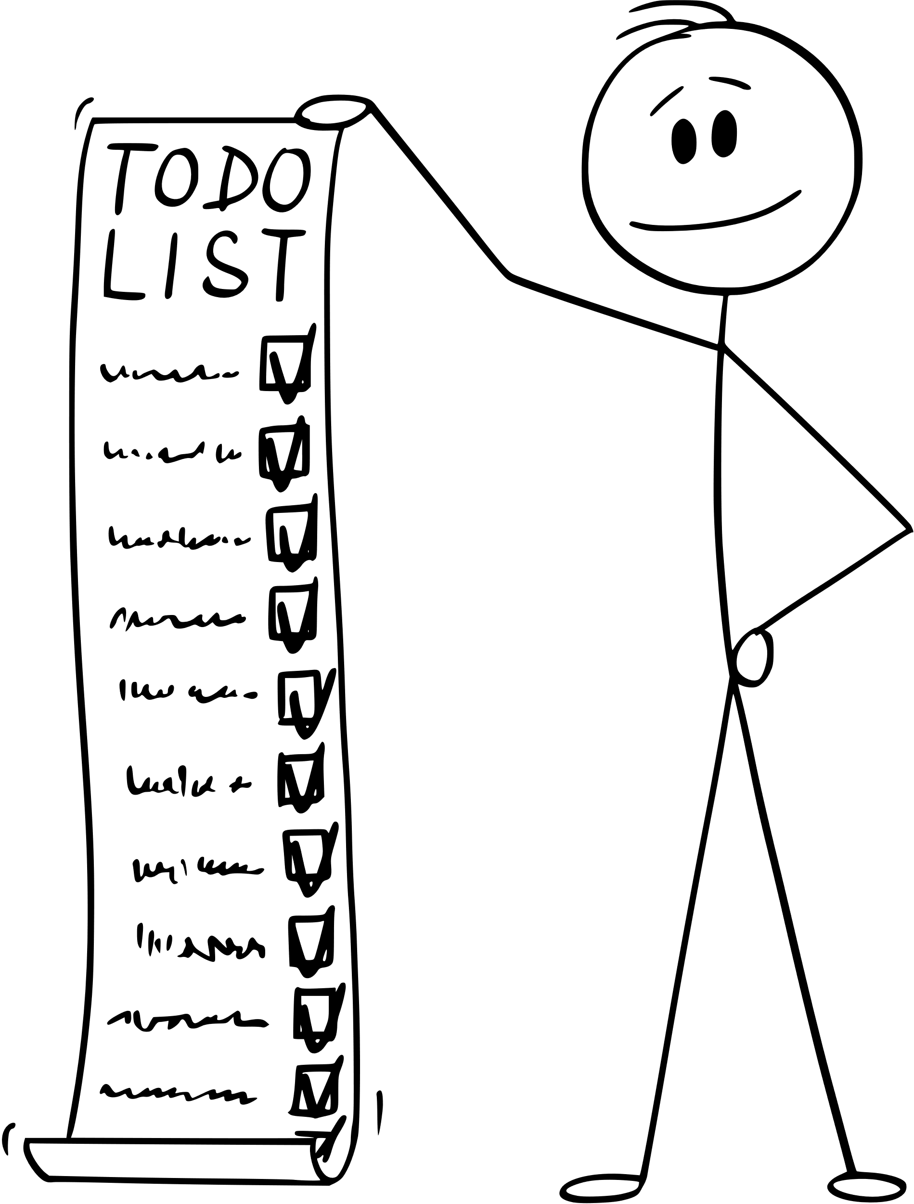
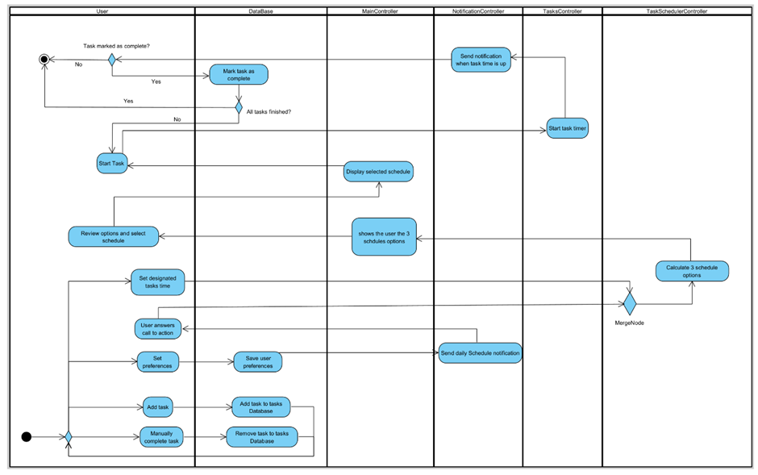
Activity Diagram

Slide 15

Task Input to Score Processes Diagram
User Input Stage
Processing Stage
Score Calculation Stage
Calculate hours until deadline
Validate input data
Process time of day preferences
Store data in database
Task Name
Deadline
Urgency (1-5 scale)
Duration
Difficulty (1-5 scale)
Urgency Component (45%)
Cognitive Load Component (35%)
Deadline Component (20%)
Final Task Score
Combined weighted score
Used for task prioritization

Slide 16

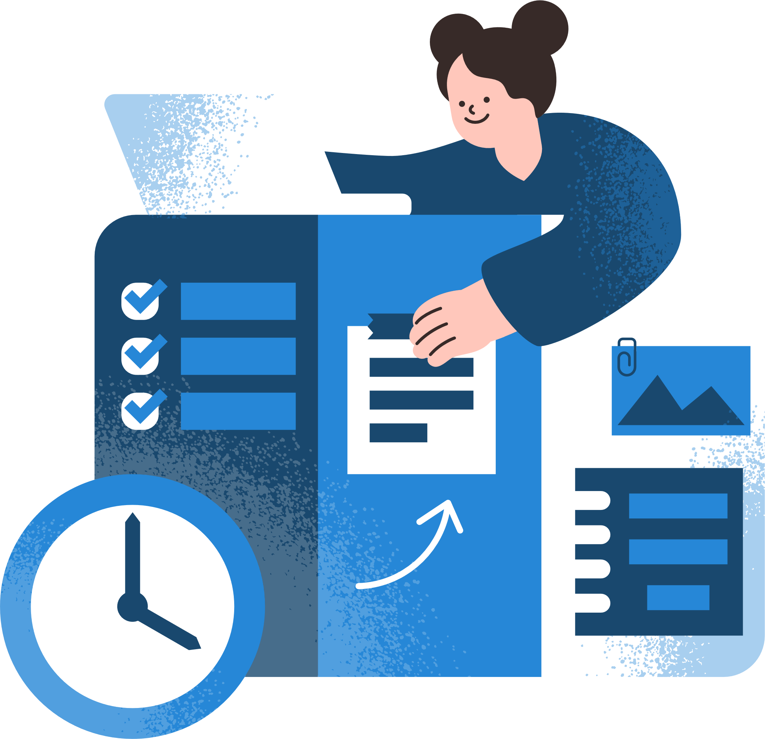
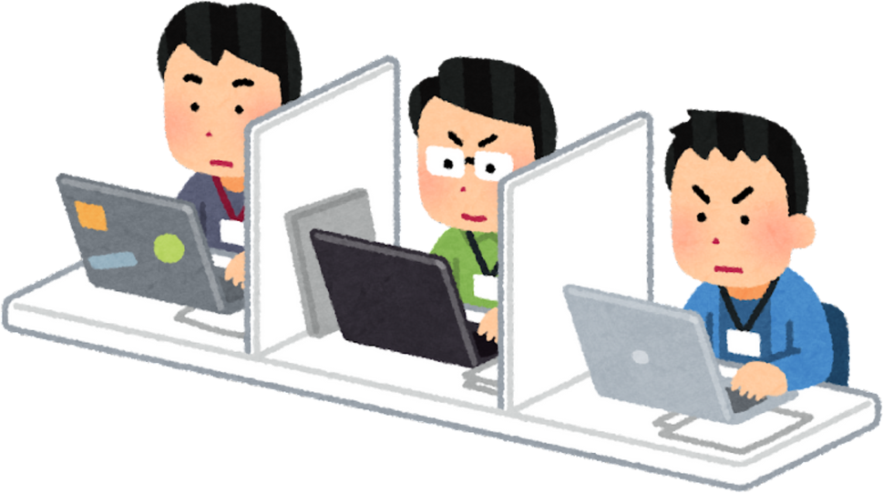
Task Score Algorithm
Urgency (45%)
Tasks are rated (1-5) based on importance.
Prioritize tasks based on urgency, cognitive effort, and deadline proximity to create a ranked task list
Cognitive Effort (35%)
Adjusts for task difficulty and user productivity patterns (e.g., morning vs. evening).
Deadline Proximity (20%)
Tasks with closer deadlines score higher
DeadlineScore = 20 * (1 / (1 + 0.01 * hoursUntilDeadline))

Slide 17
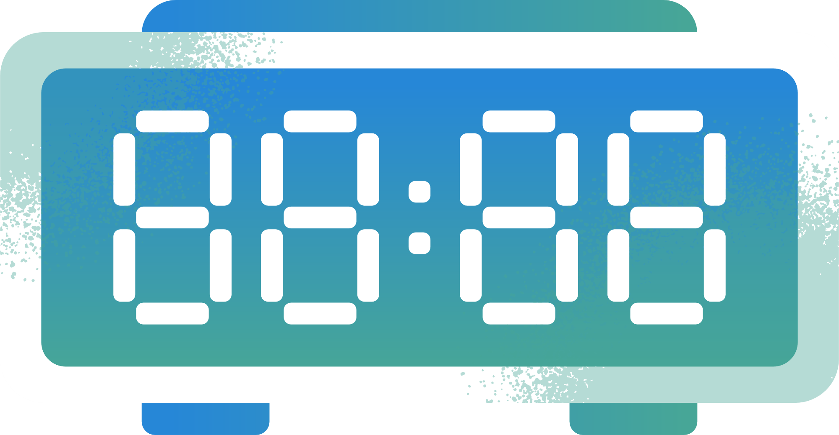
Task Allocation Algorithm
Process:
Sort tasks by priority (based on Task Score).
Generate combinations of tasks for time blocks.
Select the most balanced and productive combination
Key Considerations:
Maximizing productivity.
Balancing task difficulty across the day.
Adjusting for missed tasks dynamically.

Slide 18
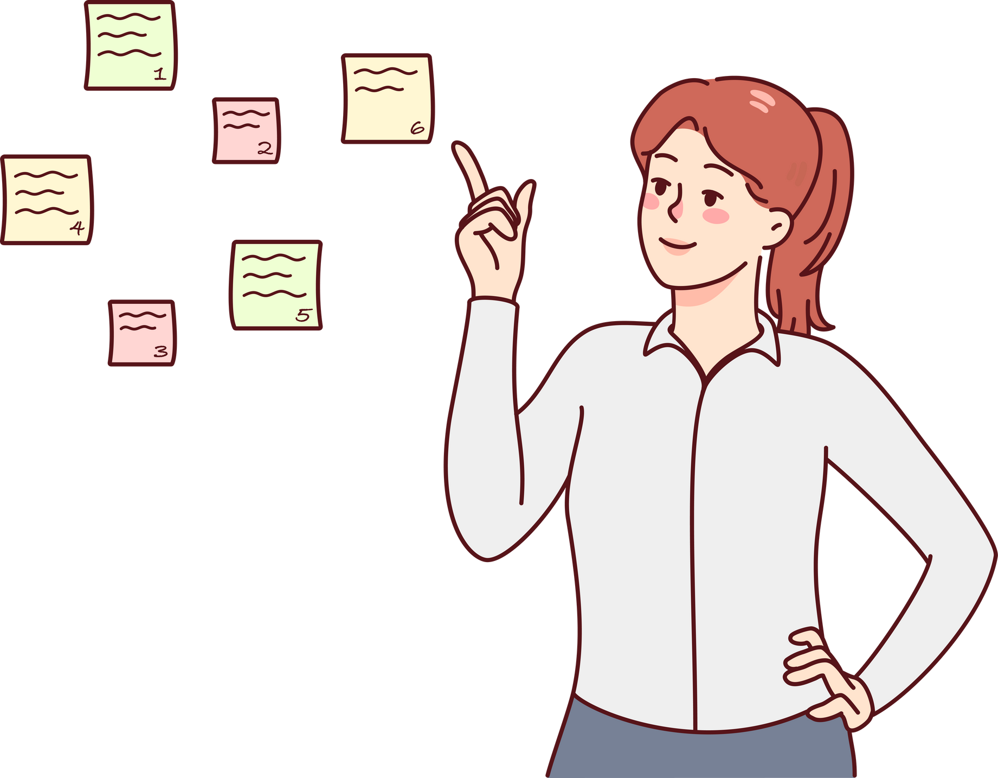
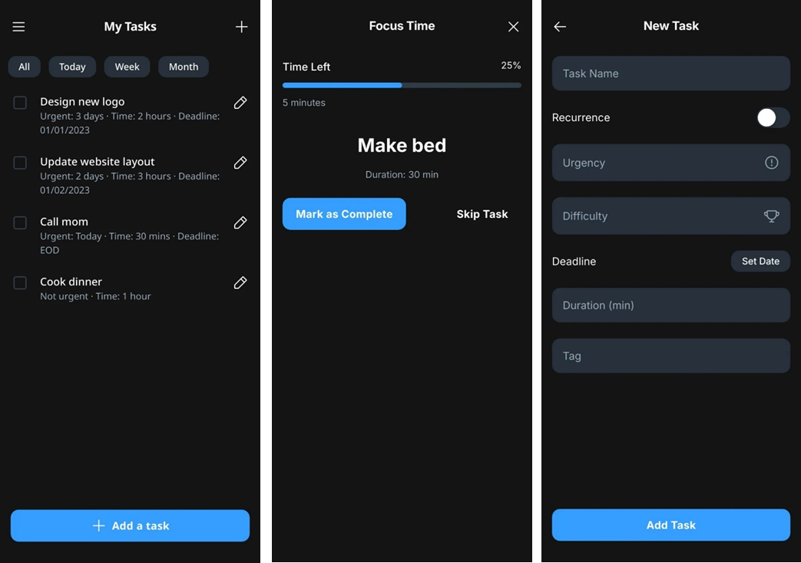
User Interface

Slide 19

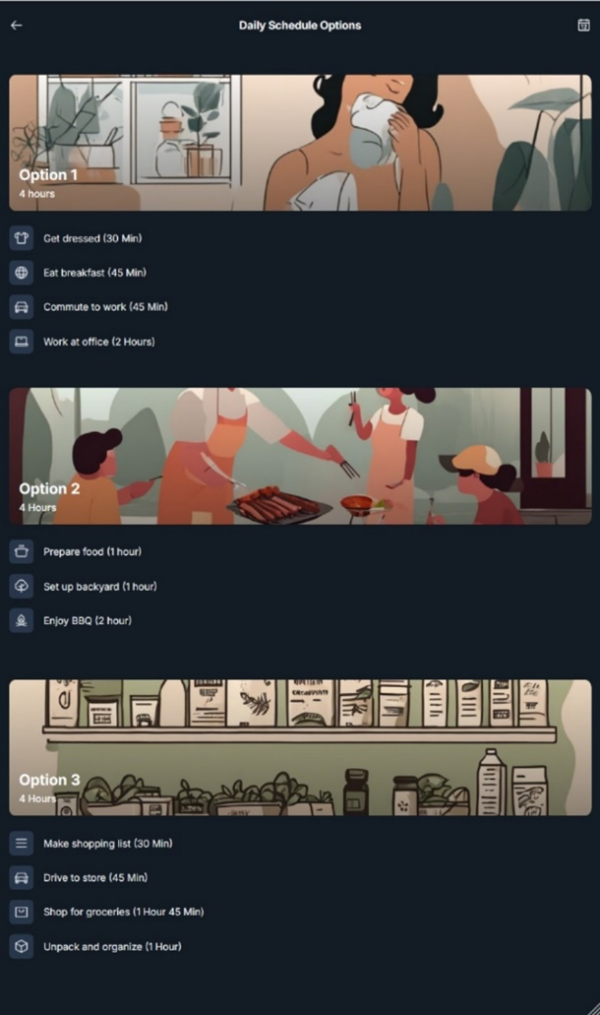
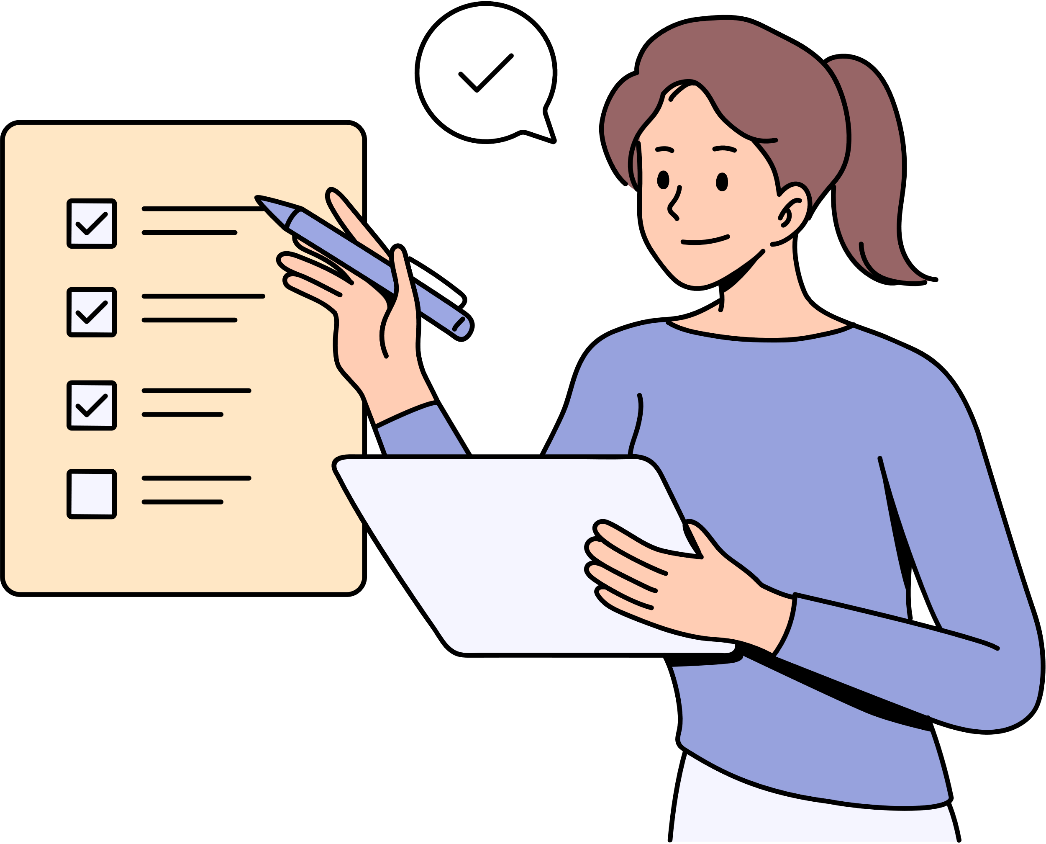
User Interface

Slide 20
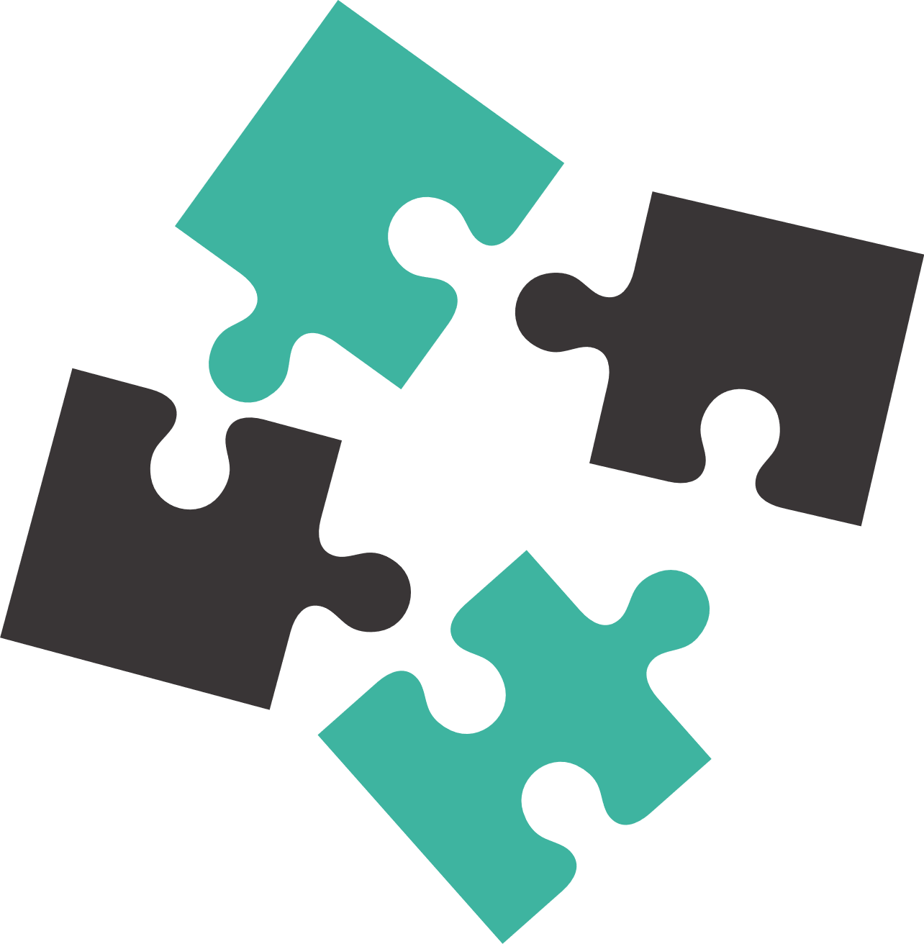
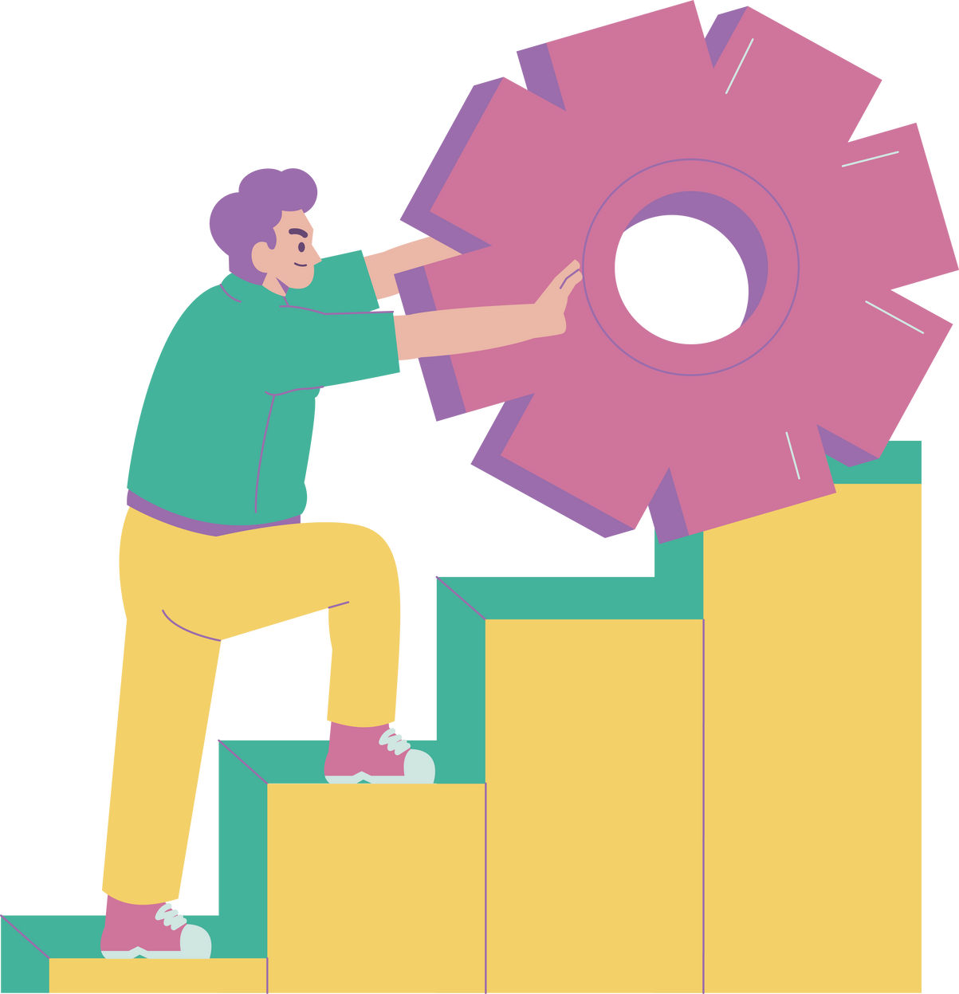
Anticipated Challenges
Customizing features for diverse ADHD symptoms.
Balancing simplicity with advanced functionality.
Ensuring real-time data synchronization.
Encouraging consistent user engagement.
Minimizing distractions within the app interface.

Slide 21
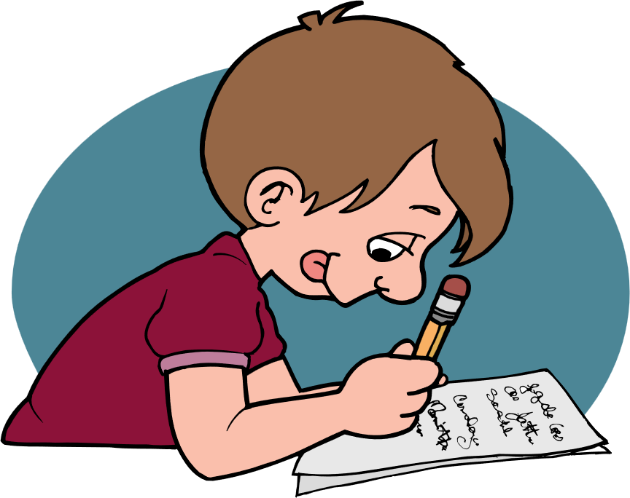
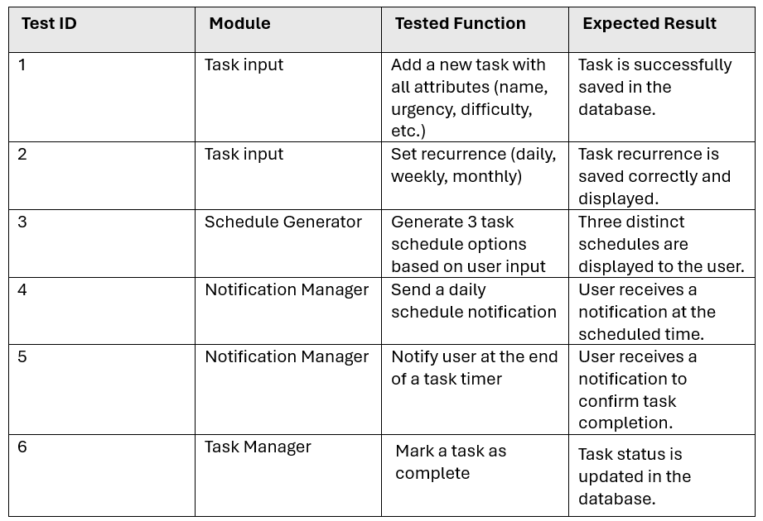
Testing Plan

Slide 22
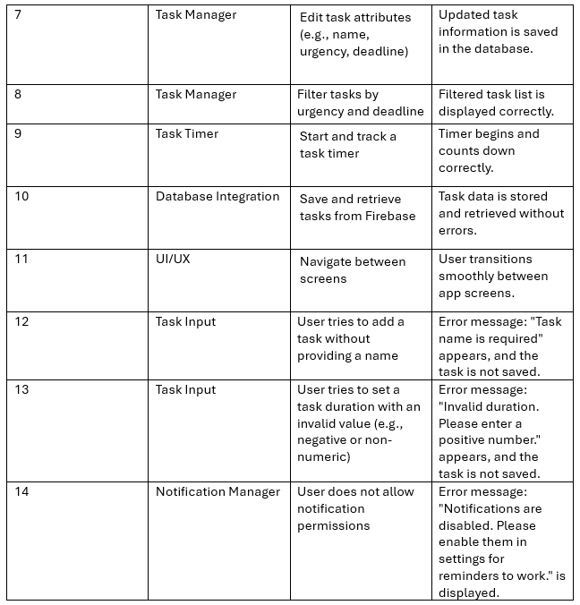
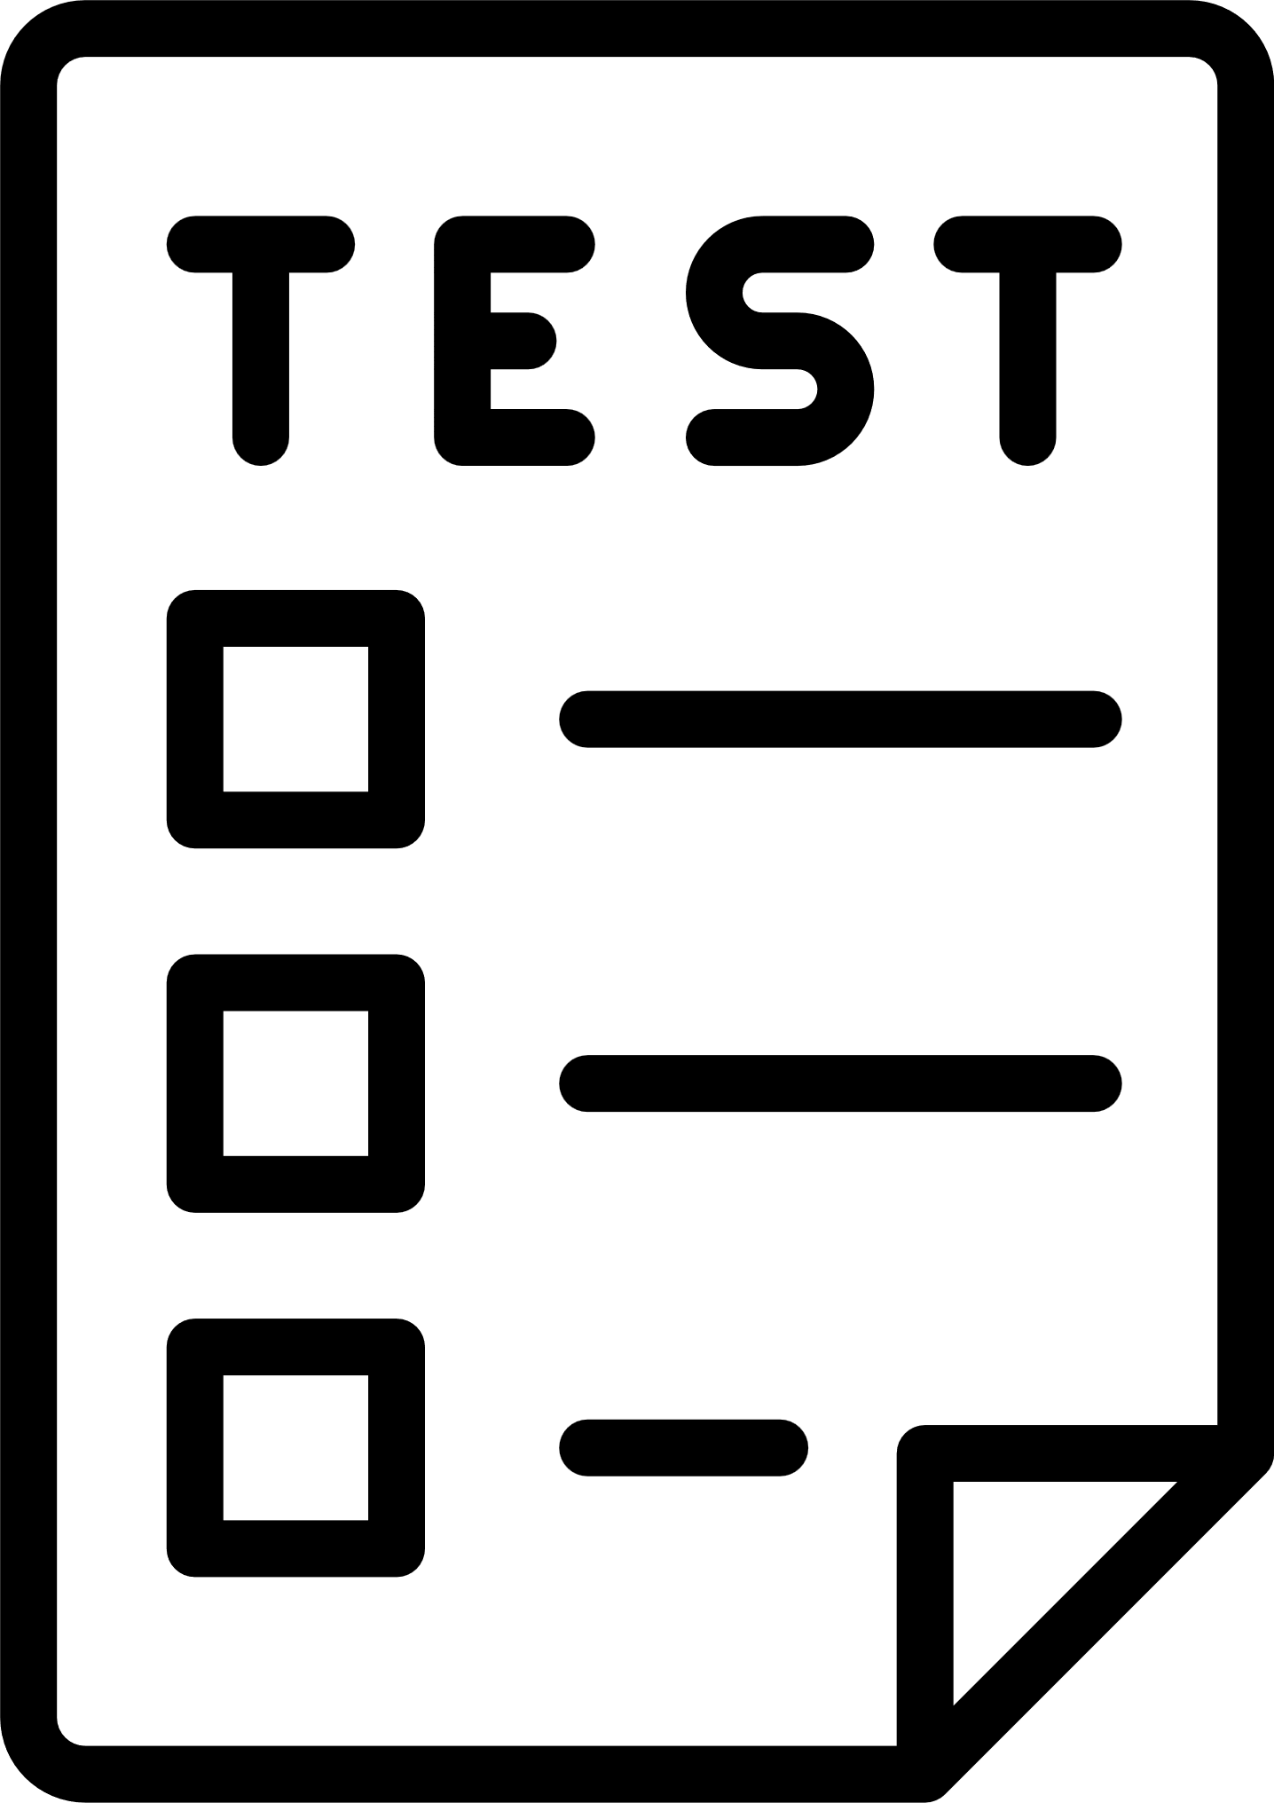
Testing Plan

Slide 23

Key Insights and expected outcomes
What We Learned:
ADHD users need adaptive systems that adjust dynamically.
Visual aids significantly enhance usability for ADHD.
A supportive design fosters better user engagement.
Expected Outcomes:
We anticipate positive feedback from users during future testing phases.
The system is designed to achieve high usability and effectiveness, addressing the key challenges identified in our research.

Slide 24
THANK YOU!

